Slide 1
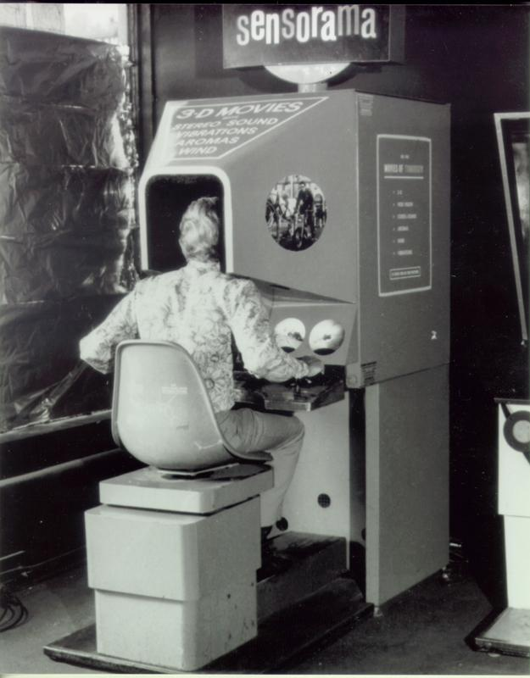
CA320 - Virtual Reality A Technical Presentation
By Nigel Guven

Slide 2
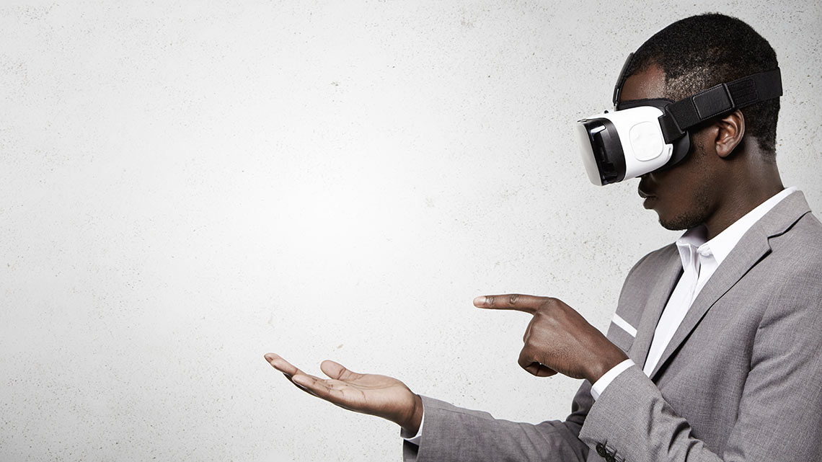
What is Virtual Reality?
Computer generated
Realism Experience in virtual environment
Currently – VR Headsets
- Projected Environments
Gyroscopes, motion sensors, omni-directional cameras
Improving technology has led to VR products and ideas

Slide 3
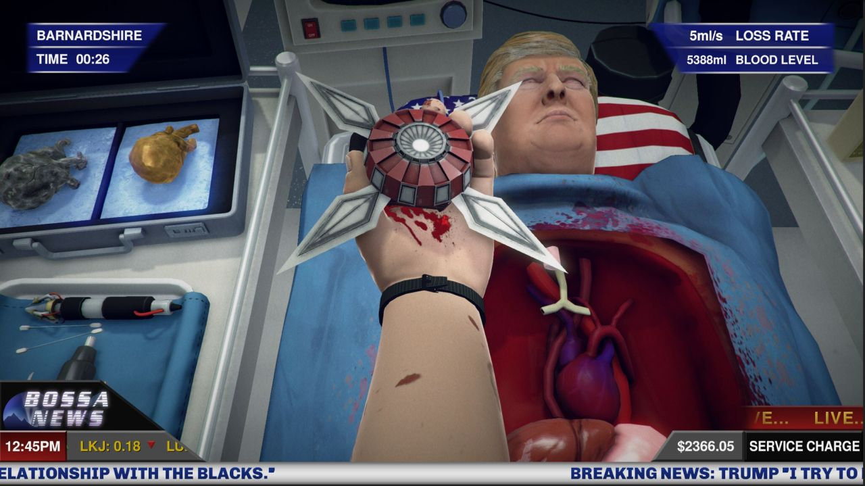
The usefulness of Virtual Reality
Obviously Video Games And Cinematics (Skip Over)
Social Science - Study for bias and stereotypes
Healthcare – Training surgeons, PTSD Exposure Therapy, Pain Experience
Education – Virtual whiteboards, online schooling
Military And Space Training
Archaeology And Urban Design

Slide 4
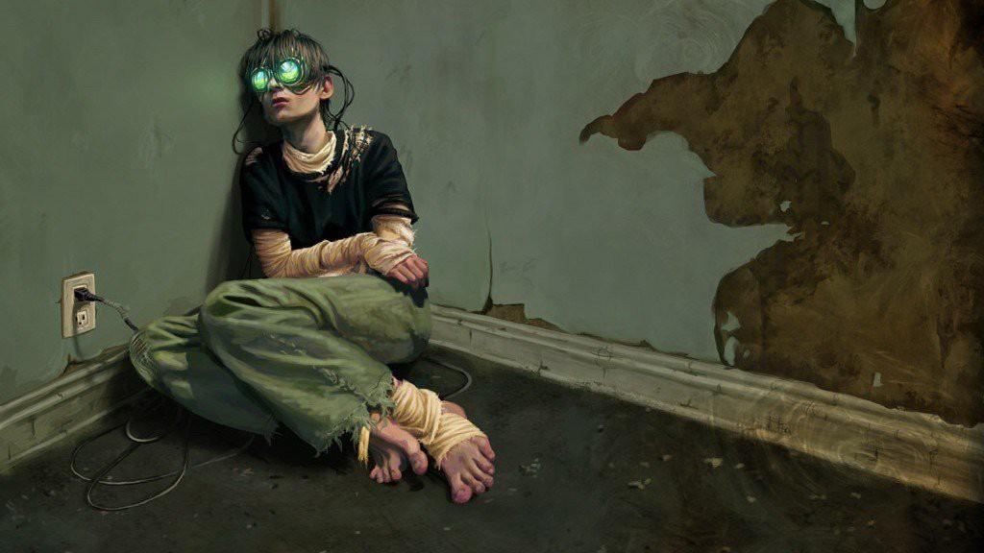
Challenges And Concern
New tech not fully understood with health and safety
Seizures, Eye Strain, Mental Issues in Children.
Natural-Virtual Collision
Safety inside virtual world
Motion Sickness – “VR Sickness”
Mass Surveillance (Im looking at you NSA!)
Philosophical - Influence Human Behaviour. Were becoming Robots!

Slide 5
Conclusion
We are at the very beginning of VR technology
Video Game Market Succesful – Steam VR, Pokemon GO
Improved Graphics and Implementations -> Cheaper VR Tech
Human Future with VR -> Will we all live in a VR world e.g. The Matrix, TRON
Any Questions, Please Ask!

